Slide 1
Lecture 9 - Angular Momentum Transport
Topics to be covered in today’s lecture:
  Angular momentum transport
    Magnetic breaking
    Stellar winds
    Gas viscosity

Slide 2
Angular Momentum Transport
Three processes have been proposed:
  Magnetic braking
  Stellar wind
  Gas viscosity
Each theory attempts to explain why the Sun now contains the majority of matter in the Solar System, and little of its AM.

Slide 3
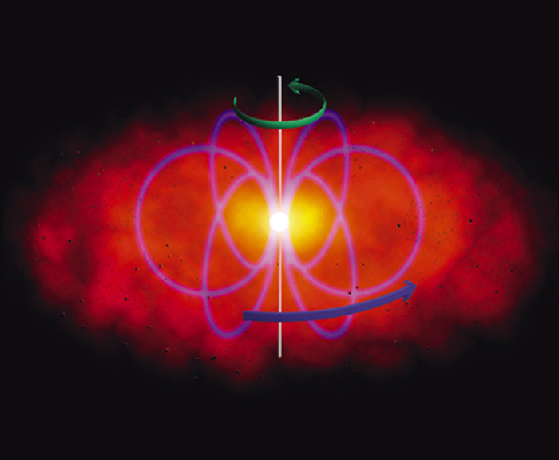
1. Magnetic breaking
Material in the inner part of the disk must be ionized. Fields are frozen if the plasma beta value is large:
where P_{G} = nkT + 1/2 ρv² and P_{B} = B² / 8 π.
If P_{G} > P_{B} => β > 1 (high beta plasma; fields frozen into plasma).
If P_{G} < P_{B} => β < 1 (low beta plasma; fields slip through plasma).
For β > 1, the magnetic field of the Sun will experience resistance as it drags through the plasma, which will slow down the rotation of the Sun.

Slide 4
1. Magnetic breaking (cont.)
Star’s magnetic field co-rotates the wind out to the Alfven Radius.
We know that the gas pressure of the wind is
P_{G} = nkT + 1/2 ρ v² = nkT + 1/2 nm v²
For v > 500 km s⁻¹, 1/2 nmv² >nkT => P_{G} ~ 1/2 nm v².
Equating the gas and magnetic pressures:
As B = M_{B} / r³ (M_{B} is the magnetic dipole moment) gives
Eqn. 1

Slide 5
1. Magnetic Breaking (cont.)
Now from conservation of mass
Substituting this into Eqn. 1 and rearranging gives
Solar wind co-roates with the magnetic field for r<r_{A}. For the Sun, r_{A} ~ 5-50R_{sun}.
Alfven Radius

Slide 6
2. Stellar wind breaking
Stellar wind literally blows the angular momentum problem away.
The total AM is L = M_{sun} vr
as v = rω (ω is the angular velocity) => L = M_{sun} r²ω.
The rate of loss of AM is
Particles lost from the star also carry away angular momentum. Given an initial mass, rotation rate, and radius, we can thus calculate the rate of AM loss.
We know that solar-type star have strong T-Tauri winds in their youth, which ultimately clear away residual gas and dust in the disk.
This theory also explains why more massive stars rotate faster: they do not have proper winds like the Sun, and therefore are not as good at losing angular momentum.
Eqn. 2

Slide 7
2. Stellar wind breaking (cont.)
Eqn. 2 only applies to equatorial regions. The correct global form for distance beyond the Alfven radius is:
where the 2/3 accounts for the fact that higher altitudes contribute less to AM losses.
Setting dL/dt ~ L/τ_{D} gives
As the AM of a spherically symmetric star is L = 2/5 Mr²ω we can then find an estimate for the spin-down time
This gives the spin-down time in terms of the mass loss rate and the Alfven radius. This predicts a spin down time of <10¹⁰ years for the Sun.
Eqn. 3

Slide 8
2. Stellar wind breaking (cont.)
But how does the angular velocity change with time depend on the mass loss rate?
We know L = 2/5Mr²ω. This gives
Equating this with Eqn. 3:
Rearranging gives
Since 3/5r² << r_{A}², we can write:

Slide 9
2. Stellar wind breaking (cont.)
Integrating then gives:
Therefore,
where M and M₀ are the final and initial masses, and ω and ω₀ are the final and initial AM.
For a particular mass loss rate, , where τ_{m} is the mass duration of mass loss.

Slide 10
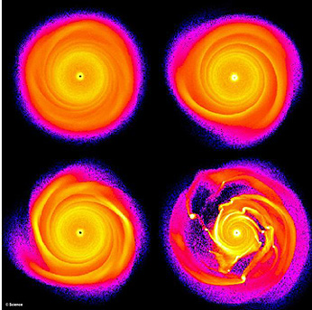
3. Gas viscosity
As well as the AM transfer of angular momentum from star to the disk, must also transport AM within the disk.
One way we can do this is by convection: numerical models shows turbulent eddies can develop, which can transport AM.
Gravitational interactions between clumps of material in the disk can cause angular momentum to be transported outwards, while gas and dust move inwards.

Slide 11
3. Gas viscosity (cont.)
The total energy associated with an orbit is: E = KE + PE = 1/2 mv² - GMm/r².
For a circular orbit, mv²/2 = GMm/r² => v² = GM/r.
Therefore
The angular momentum is given by
Lynden-Bell and Pringle (1974) considered how AM could be transported in a disk. Take two bodies in circular orbits with masses m₁ and m₂. The total energy and AM of the system are:
m₁
r₁
r₂
m₂
Eqn. 4
Eqn. 5

Slide 12
3. Gas viscosity (cont.)
Now suppose the orbits are perturbed slightly, while conserving L, Eqns.4 and 5 become:
Eqn. 7 implies that
Substituting this into Eqn. 6 gives
Eqn.6
Eqn.7
m₁
r₁
r₂
m₂
If r₁ < r₂ we can reduce the energy of the system if δr₁ <0 i.e. moving m₁ closer to the center. Thus the
energy can be reduced while conserving AM by moving the initially closer body in and moving the
initially outer body further out => all the mass is concentrated near the inner parts of the solar system,
while the AM occupies the outer parts.

Slide 13
Properties of the Solar System
All the planets' orbits lie roughly in the ecliptic plane.
The Sun's rotational equator lies nearly in this plane.
Planetary orbits are slightly elliptical, very nearly circular.
The planets revolve in a west-to-east direction. The Sun rotates in the same west-to-east direction.
The planets differ in composition. Their composition varies roughly with distance from the Sun: dense, metal-rich planets are in the inner part and giant, hydrogen-rich planets are in the outer part.
Meteorites differ in chemical and geologic properties from the planets and the Moon.
The Sun and most of the planets rotate in the same west-to-east direction. Their obliquity (the tilt of their rotation axes with respect to their orbits) are small. Uranus and Venus are exceptions.
The rotation rates of the planets and asteroids are similar-5 to 15 hours.
The planet distances from the Sun obey Bode's law.
Planet-satellite systems resemble the solar system.
The Oort Cloud and Kuiper Belt of comets.
The planets contain about 99% of the solar system's angular momentum but the Sun contains over 99% of the solar system's mass.

